Slide 1
Design Synthesis
The fun part…
Lecture Week 4
Deck 2
Mr DJ Kritzinger
August 2026

Slide 2
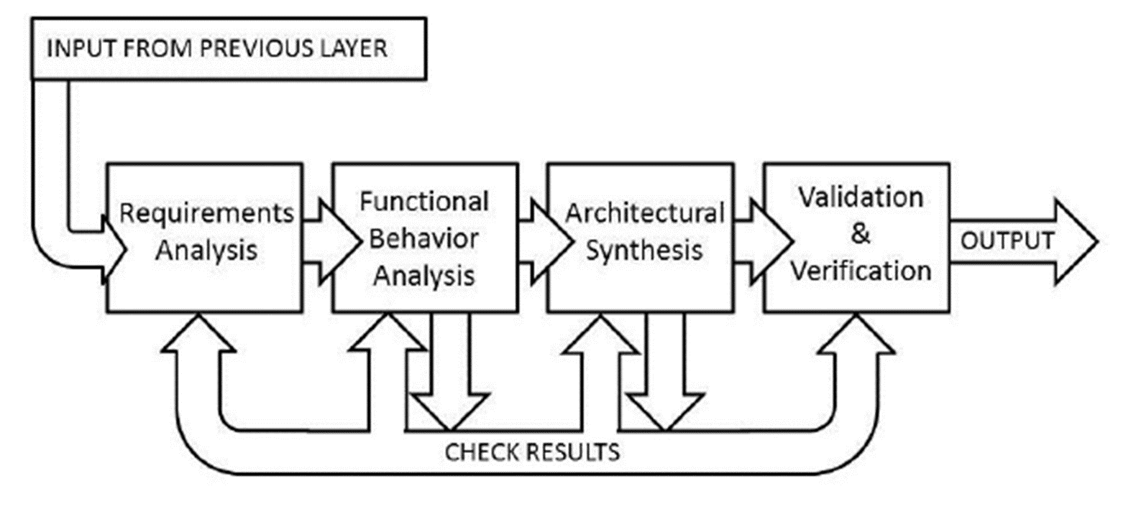
Perspective
Notes:
Previously, we analysed the requirements and determined the completeness thereof. Once you were happy with the requirements, you proceeded to conduct the functional analysis.
During the FA multiple missing / unclear requirements issue may be identified, and thus you return to RA to rectify these.
From RA you proceed to FA (again) and fix any resulting issues (perhaps only some updates are required). Then proceed to Architectural Synthesis.

Slide 3

Architectural Synthesis / Physical Design
Process by which designs are developed based on Functional Analysis
Creative activity
Hardware and Software elements are considered as physical elements
Multiple plausible architectures are likely
Trade studies selects optimal architecture

Slide 4
Aid understanding
Functional Units (F/U) present components inside the system boundary
System boundary contains all elements under SE’s control
Interfaces (I/F) to other components are presented by bold intersecting lines. Numbering maintains traceability
All elements are represented by rectangular blocks
Physical architectures are presented by schematic block diagrams
NOT an electrical schematic
Graphical rules apply
Denotes connectivity

Slide 5
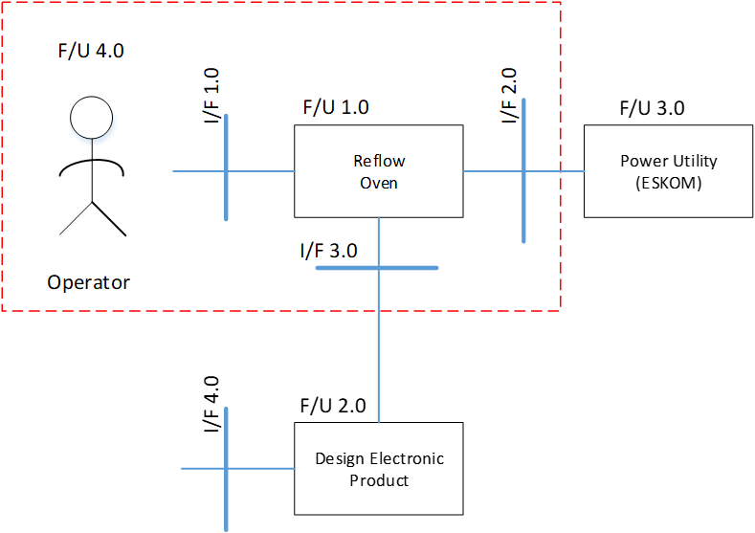
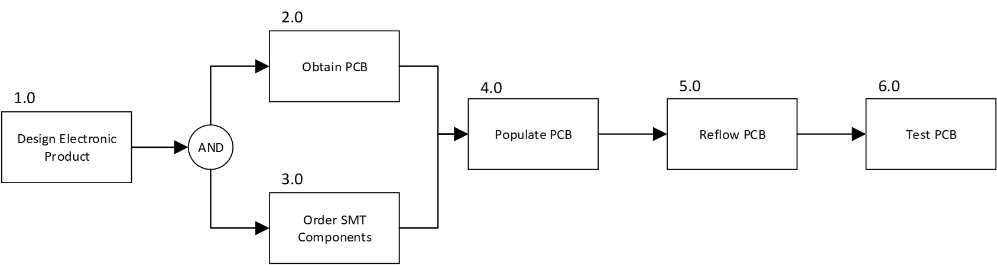

More questions
“HOW” things are done
How is the physical architecture arrived at?
Map functions to functional units
Complete RA to avoid unnecessary iteration
This direction is also possible
Describes “WHAT” must be done
Notes:
If there are specific design requirements (such as “must make use of XYZ”) then aspects of the physical architecture is already available. In such cases it may be sensible to iterate the architecture and flow analysis…

Slide 6
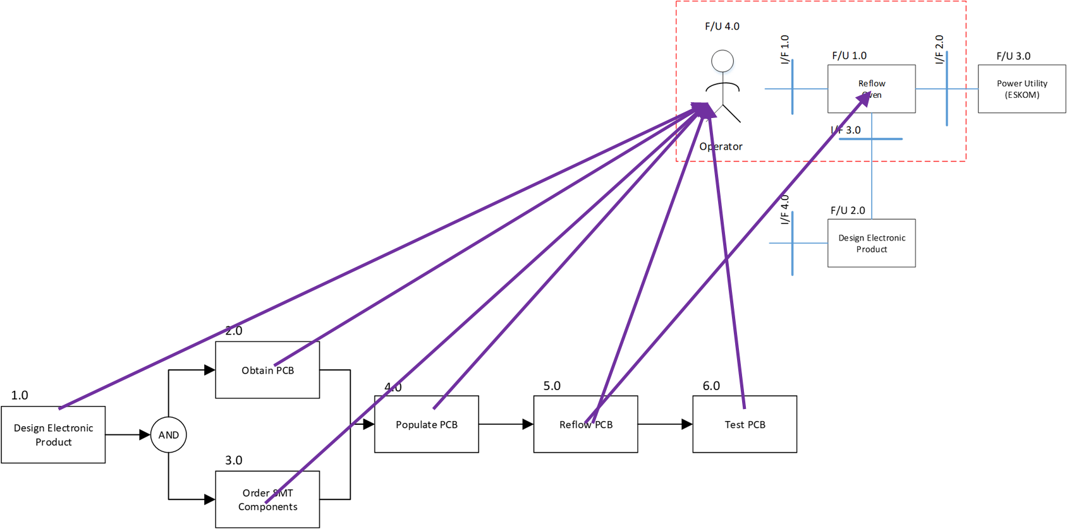
Is the design valid?
Unused resources indicative of “over design” (adding unused features)
Can your proposed architecture perform all the functions?
Construct a resource allocation matrix
Functions that are not performed by any resources indicates an invalid design!
 | Resources
Function | F/U 1.0 - Reflow Oven | F/U 2.0 - Populated PCB | F/U 3.0 - Power Utility | F/U 4.0 - Operator
1.0 - Design Electronic Product |  |  |  | •
2.0 - Obtain PCB |  |  |  | •
3.0 - Order SMT components |  |  |  | •
4.0 - Populate PCB |  |  |  | •
5.0 - Reflow PCB | • | • | • | •
6.0 - Test PCB |  | • |  | •

Slide 7
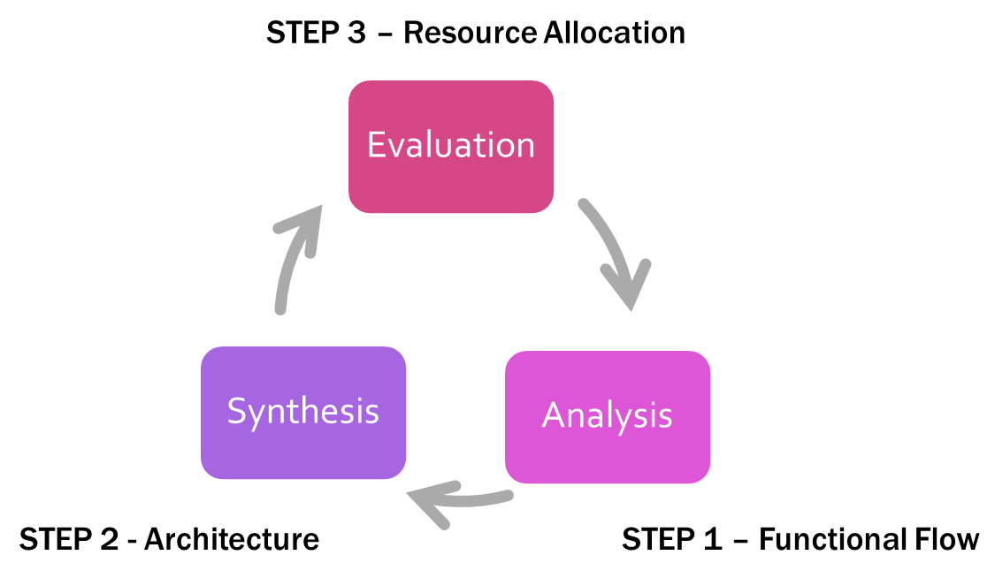
Resource Allocation
Can be used to identify under/over designed solutions
No performance validation can be done!
Notes:
This loop provides a mechanism by which to evaluate your work. A functional analysis (what needs to be done) must be performed by some architecture (how things are done) and the evaluation ensures that you have a) not missed an architecture element and b) that you’ve not started adding features just because….
BUT
There is no way to automatically check if your functional analysis is correct. You can map required functionality to elements in the functional analysis but this remains something based on the systems engineer’s skill level. Particularly when considering that a system requirement (toast bread) will map to many functional elements.

Slide 8
Requirements / Design loops
Requirements Loop
Design Loop
Actions system must perform and performance limits
Restrictions or other imposed constraints
How system functions are to be performed
Typically multiple alternatives

Slide 9
Requirements flow-down
Initially requirements are assigned to the system as a whole
As analysis proceeds, relevant requirements are assigned to F/U 1.0
Includes interfacing requirements
This allows system level requirements to be traced to “as implemented”

Slide 10

A toaster
The system shall toast a maximum of two slices of bread to a user selected degree in no longer than 5 minutes.
The system shall be connected to a 220Vrms 50Hz SANS 1204 plug socket.
Notes:
To a large degree the top level architecture can be inferred from the context diagram. It should, however, be remembered that the CD is used to place the system in an operational context. As such the architecture may exclude elements of the context diagram.
Consider the case of a CD that contains a rat that can chew on utility cables. Although our system will be required to handle the effects of the rat, the rat itself is not part of the system physical architecture.

Slide 11
A small example
For all of these functions F/U 1.0 will need to respond
So you are in effect placing requirements on “My Toasting
Device”
Requirements for F/U 1.0
Display options to user
Capture user selection
Store user selections
Capture “start of process”
Perform process functions
Indicate status of process
Notes:
We start of by performing a functional analysis of the system at hand, and connect requirements at system level to elements in our physical architecture.
Remember that something must perform the functions. So functions that remain unaccounted for is not acceptable.

Slide 12
DECOMPOSE
CLASS ACTIVITY
1
Ask “How” / “With What?”
2
Update architecture
Notes:
The decomposition here is not super important and more than one possibility exists. This forms part of the creative aspect of design.

Slide 13
Requirements Analysis
As an example consider F 3.5.8.4
Rate of temperature increase?
Maximum temperature?
Toasting temperature shall not exceed 180 ⁰C maximum applied at a rate of 10 ⁰C/s when actively toasting.

Slide 14
IMPORTANT
Traceability is maintained when decomposing to lower levels

Slide 15
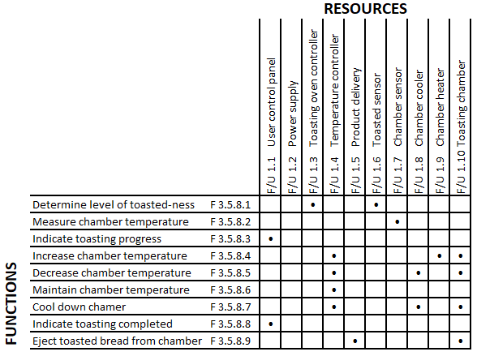
Verify if we are on the right track
Resource allocation seems to be OK…
Power supply is not used by any function?

Slide 16
Flow-down requirements
Toasting temperature shall not exceed 180 ⁰C maximum applied at a rate of 10 ⁰C/s when actively toasting.
Maximum temperature 180 ⁰C
Rate of change min 10⁰C/s

Slide 17
Wrap-up
Discussed how requirements analysis is accomplished
Seen how functional analysis can be used as a analysis / design tool
Explored the basics of physical design
Looked at resource allocation as a means of design validation
Seen how requirements are flowed-down during decomposition

